Slide 1



Project: AMBA3 APB Protocol
Presented By: Adnan Ashraf
BTech-ECE(2017-2021)
Soc Verification Intern : Sion Semiconductors Pvt. Ltd
Github Profile: https://github.com/adnanashraf17501
https://github.com/adnanashraf17501

Slide 2
Index:
Introduction : Evolution Of AMBA and APB Protocol.
Various AMBA Protocols- High Level Difference
AMBA APB Protocol Versions.
AMBA APB Enhancement to AMBA 3 APB v2.0
APB Master/Slave Configurations.
APB Working/Operation
APB UVM Verification Report and Simulation
https://github.com/adnanashraf17501

Slide 3
Introduction: Evolution Of AMBA and APB Protocol.
The ARM Advanced Microcontroller Bus Architecture (AMBA) is an open-standard, on-chip interconnect specification for the connection and management of functional blocks in system-on-a-chip (SoC) designs.
It facilitates development of multi-processor designs with large numbers of controllers and components with a bus architecture.
Since its inception, the scope of AMBA has, despite its name, gone far beyond microcontroller devices.
Today, AMBA is widely used on a range of ASIC and SoC parts including applications processors used in modern portable mobile devices like smartphones.
AMBA is a registered trademark of ARM.
AMBA was introduced by ARM in 1996
https://github.com/adnanashraf17501

Slide 4
Evolution Of AMBA:
a
CHI
ACE
a
a
ACE5
a
ACE-LITE
a
a
AXI5
AXI3
AXI4
a
AXI-LITE
a
AXI4-Stream
a
a
AHB
AHB-LITE
a
AHB5
a
APB2
APB3
APB
a
a
a
APB4
`1995 `1996 `2003 `2010-2011 `2013-2016
https://github.com/adnanashraf17501

Slide 5
Various AMBA Protocols- High Level Difference:
APB AXI-LITE
Used for Connecting Low peripherals. Simplified version of AXI4 full
Simple Non-Pipelined Protocol. No support of burst data transfer.
Shared Bus from single master to multiple slaves.
AHB AXI4-stream
Used for connecting components that need higher B.W on shared bus. Single direction data transfer
Shared bus with multiple masters and slaves. Useful for designs such as video streaming.
Maximum concurrency of transactions is 2.
Higher B.W is possible through burst transfers.
AHB-LITE ACE
Simplified version of AHB AXI Coherency extension over AXI4.
Single master and multiple slaves. Extends AXI read, write channels and introduces
Removes need for arbitration, retry and split transactions. new snoop requests & response channels.
AXI CHI
Used for higher B.W, low latency interconnects. Complete redesign of ACE uses no. Of coherent
Pipelined Protocol. clusters.
Supports out of order responses, data interleaving. use packet based layered protocol
Separate RD/WR paths.
https://github.com/adnanashraf17501

Slide 6
AMBA APB PROTOCOL Versions:
AMBA2 APB (APB2)
-> Basic Read and Write transfers.
AMBA3 APB 1.0 (APB3)
-> Wait states: A ready signal, 'PREADY' to extend an APB transfer.
-> Error Reporting: An error signal, 'PSLVERR' to indicate the failure of a transfer.
AMBA3 APB 2.0 (APB4)
-> Transaction Protection – Protection Signal to support secure/non-secure transactions
-> Sparse Data Transfer – Write strobe signal to enable sparse data transfer on the write bus.
https://github.com/adnanashraf17501

Slide 7
INTRODUCTION : APB PROTOCOL
APB Stands for 'Advanced Peripheral Bus'.
Used for low bandwidth communication only.
Mainly used as general purpose register based peripheral such as timers, interrupt controllers, UART`S, IO ports etc.
Optimized for minimal power consumption and reduced interface complexity.
Every transfer takes at least 2 cycles, one cycle called as "setup phase" and second one as "access phase".
It’s a non-pipelined protocol.
Its connected to the system bus via bridge, helps in reducing system power consumption.
Easy to interface.
Provides a low cost interface that is optimized for minimal power consumption and reduced interface complexity.
It has two independent data buses, one for write data and one for read data but no handshaking.
Buses can be up to 32 bits wide.
https://github.com/adnanashraf17501

Slide 8
AMBA3 APB INTERFACE ARCHITECTURE:
PSEL 0
PSEL 1
SLAVE 0
PSEL 2
PENABLE
PPADDR
PWRITE
MASTER
PWDATA
APB INTERFACE
SLAVE 1
PRDATA
PREADY
SLAVE 2
PSLVERR
https://github.com/adnanashraf17501

Slide 9
Enhanced AMBA3 APB4 ARCHITECTURE4: PPROT & PSTRB
PSEL 0
PSEL 1
SLAVE 0
PSEL 2
PENABLE
PPADDR
PWRITE
MASTER
PWDATA
APB INTERFACE
SLAVE 1
PPROT
PSTRB
PRDATA
PREADY
SLAVE 2
PSLVERR
https://github.com/adnanashraf17501

Slide 10
APB INTERFACE SIGNALS:
Write
Signals | Source | Description
PCLK | CLOCK | Clock.
PRESTn | SYSTEM BUS | Reset. The APB reset signal is active low.
PADDR | APB BRIDGE | APB Address bus, 32 bits wide.
PPROT | APB BRIDGE | Protection type. Indicate privileged/normal, secured/non-secured transaction.
PSELx | APB BRIDGE | Slave select signal.
PENABLE | APB BRIDGE | Enable signal.
PWRITE | APB BRIDGE | Direction. When 1, write access else read access.
PWDATA | APB BRIDGE | Write data bus, 32 bit wide.
PSTRB | APB BRIDGE | Write strobes, one write strobe bit for each 8 bits.
PREADY | SLAVE | Ready signal
PRDATA | SLAVE | Read data, 32 bits wide.
PSLVERR | SLAVE | Indicates transfer failure
https://github.com/adnanashraf17501

Slide 11
APB MASTER CONFIGURATION:
If there is a single master on the APB, no need for arbiter.
Master drives the address and write buses, also performs a combinational decode of address to decide PSELx signal to activate.
It is also responsible for driving the PENABLE to time the transfer.
It drives APB data onto the system bus during the read transfer
APB SLAVE CONFIGURATION:
APB slave has a very simple and flexible interface.
PSLVERR & PREADY are two main signals which decides the key operation while data transfer
https://github.com/adnanashraf17501

Slide 12
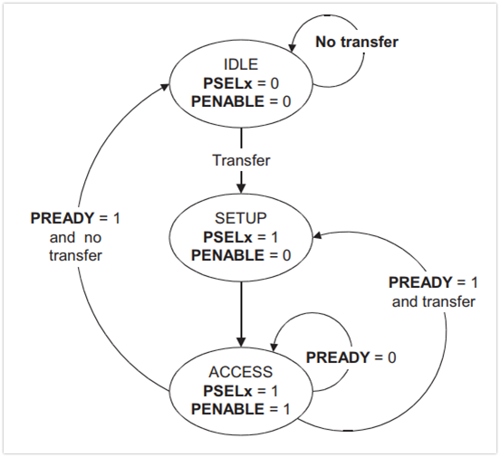
APB OPERATING STATES:
IDLE : This is the default state of APB.
SETUP : When transfer is required, PSELx is asserted then the bus moves in setup state. Bus only remains in SETUP for only one clock cycle and always moves to ACCESS state on next rising edge of clock. So, the slave must be able to sample the Address and control information in the SETUP cycle itself.
ACCESS : PENABLE is asserted to enter into the ACCESS state. The PADDR, PWRITE, PSELx and PWDATA signals must remain stable during ACCESS state.
https://github.com/adnanashraf17501

Slide 13
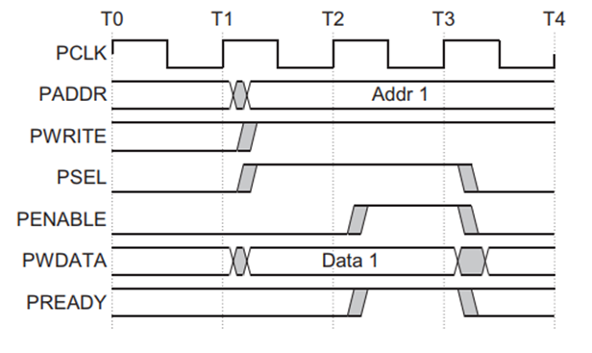
APB WRITE TRANSFER WITH NO WAIT STATES:
At T1, a write transfer with address PADDR,PWDATA,PWRITE and PSEL starts.
They will registered at the next rising edge of PCLK, T2.
This is Setup Phase of Transfer.
After T2, PENABLE and PREADY are registered at the rising edge of PCLK.
When asserted, PENABLE indicates starting of ACCESS Phase
When asserted, PREADY indicates that slave can complete the transfer at the next rising edge of PCLK.
PADDR, PDATA and control signals all should remain valid till the transfer completes at T3.
PENABLE signal will be de-asserted at the end of transfer.
PSEL is also de-asserted, if next transfer is not to the same slave.
https://github.com/adnanashraf17501

Slide 14
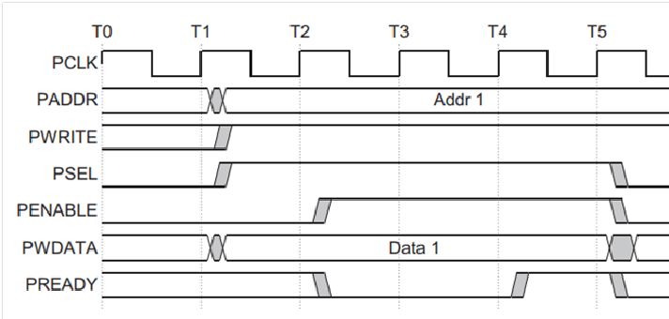
APB WRITE TRANSFER WITH WAIT STATES:
During the ACCESS Phase, when PENABLE is high, the slave extends the transfer by driving PREADY low.
The PADDR, PWRITE, PSEL, PENABLE, PWDATA, PSTRB, PPROT signals should remain unchanged while PREADY is low
PREADY can take any value when PENABLE is low.
It is recommended that the address and write signals are not changed immediately after a transfer, but remain stable until another access occurs.
https://github.com/adnanashraf17501

Slide 15
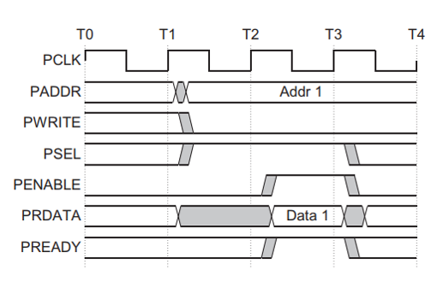
APB READ WITHOUT WAIT STATE:
At T1, a READ transfer with address PADDR, PWRITE and PSEL starts.
They will be registered at rising edge of PCLK.
This is SETUP Phase of the transfer.
After T2, PENABLE and PREADY are registered at the rising edge of PCLK.
When asserted, PENABLE indicates the starting of ACCESS phase.
When asserted, PREADY indicates that slave can complete the transfer at next rising edge of PCLK by providing the data on PRDATA.
Slave must provide the data before the end of read transfer. i.e. before T3.
https://github.com/adnanashraf17501

Slide 16
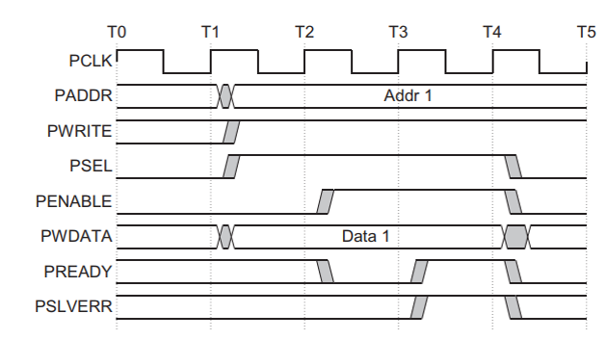
APB READ WITH WAIT STATE:
During the ACCESS Phase, when PENABLE is high, the slave extends the transfer by driving PREADY low.
The PADDR, PWRITE, PSEL, PENABLE, PPROT signals should remain unchanged while PREADY is low
https://github.com/adnanashraf17501

Slide 17
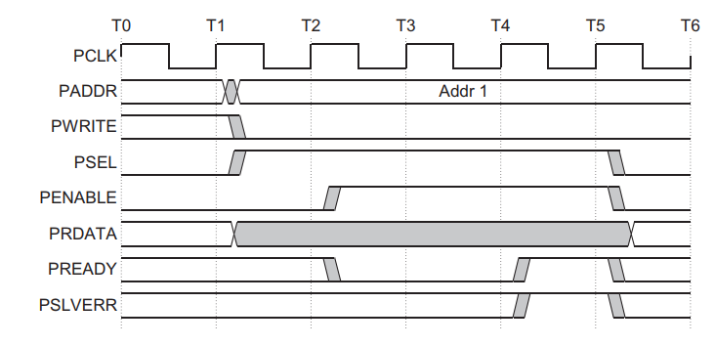
APB ERROR RESPONSE:
Whenever there is a problem in the transfer, Slave indicates the error response for the transfer by asserting the PSLVERR signal. PSLVERR is only considered valid during the last cycle f and APB transfer, when PSEL, PENABLE and PREADY are all HIGH. It is recommended, but not mandatory that you drive PSLVERR low when it is not being sampled.
Transactions that receive an error response, might or might not have changed the state of peripheral. For example, If APB master performs a write transaction to an APB slave and received an error response, it is not guaranteed that the data is not written on the slave peripheral.
https://github.com/adnanashraf17501

Slide 18
Protection Unit Support:
To support complex system designs, it is often necessary for both the interconnect and other devices in the system to provide protection against illegal transactions. It is provided by Protection Unit in APB Protocol. The signals indicating the protection unit are PPROT[2:0].
The three levels of access protection are
PPROT[0]:
LOW indicates Normal Access
HIGH indicates Privileged Access
PPROT[1]:
LOW indicates Secure Access
HIGH indicates Non-Secure Access
PPROT[2]:
LOW indicates Data Access
HIGH indicates Instruction Access
https://github.com/adnanashraf17501

Slide 19
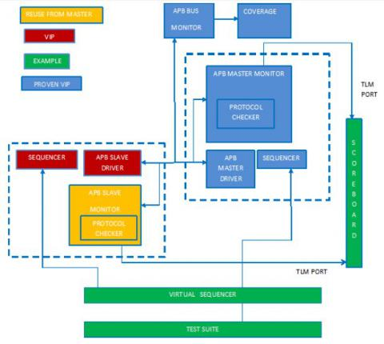
UVM APB Verification:
https://github.com/adnanashraf17501

Slide 20
APB PROTOCOL UVM VERIFICATION: Components
I. UVM Testbench: In UVM Testbench, Design Under Test (DUT) and UVM Test class are instantiated and connections between them are configured.
UVM Test: This is the top level component present in the Testbench. It is responsible for instantiating and configuring the top-level environment. It will also invoke sequences for applying the stimulus to DUT.
UVM Environment: This is responsible for instantiating other verification components that are inter related to each other . Components like UVM scoreboard and UVM Agent are instantiated under this.
UVM Scoreboard: This will carry out the checking of behavior of DUT . This component usually receives the output from UVM monitor as input and will compare with expected output.
UVM agent: In this other verification components are included that are dealing with DUT interface. In this component UVM Sequencer is responsible for stimulus flow and UVM Driver is responsible for applying stimulus on DUT and UVM monitor is responsible for collecting the output from DUT transaction level stimulus for carrying out the operations. UVM Test bench is created by instantiating Design Under Test and UVM Test .
UVM Sequencer: It is like an arbiter for controlling transaction flow from multiple stimulus sequences .
UVM Driver : It will receive sequence-items from UVM sequencer and applies it on DUT interface. So driver has also to convert a transaction level stimulus into pin level stimulus for applying the data.
UVM monitor : It will capture the output present at transaction in DUT interface and will also sent out the data to rest of UVM Test bench based on connections made . Monitor also has to convert the pin level stimulus to transaction level stimulus for carrying out the operations.
https://github.com/adnanashraf17501

Slide 21
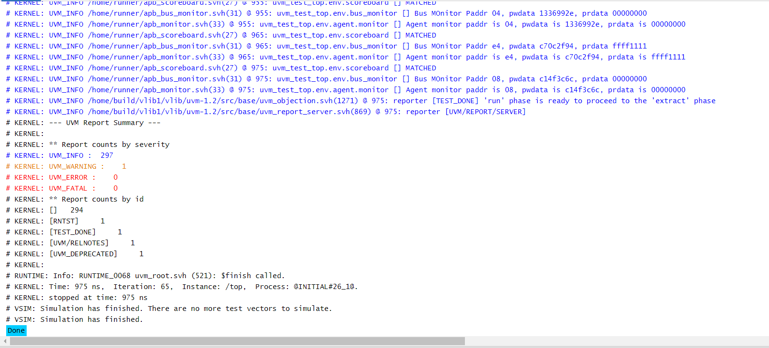


UVM Report using Questa Sim and edaplayground.com/AldecRivieraPro2020.04
https://github.com/adnanashraf17501

Slide 22
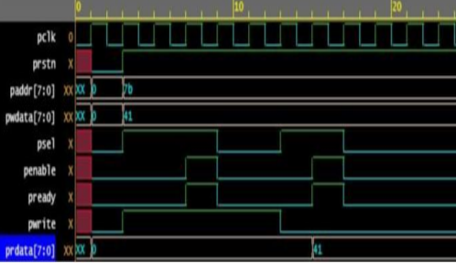
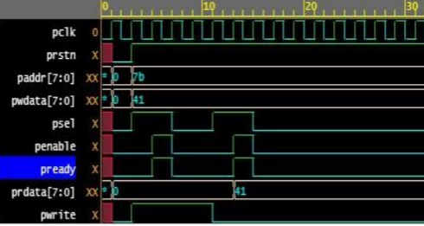
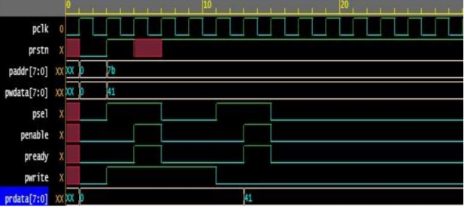
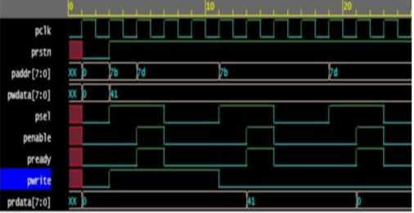
UVM Simulation: Test Description
T1: Writing data to design and reading back the data from design which is associated with APB protocol
T3: Here at first positive edge of clock sel signal and write signal are asserted along with address and data . At next edge of clock the address value is changed with the assertion of enable signal. After the write transfer completed, Read transfer will be done
T2 :While writing data to design , PENABLE signal has to be asserted low for two clock cycles after PSELx enabled and reading back the data from design which is associated with APB protocol. This is an negative scenario.
T4: Here, while write transfer is going on reset is applied with value x . This action is taken into consideration to check whether the reset with x is effecting the design or not .
https://github.com/adnanashraf17501

Slide 23
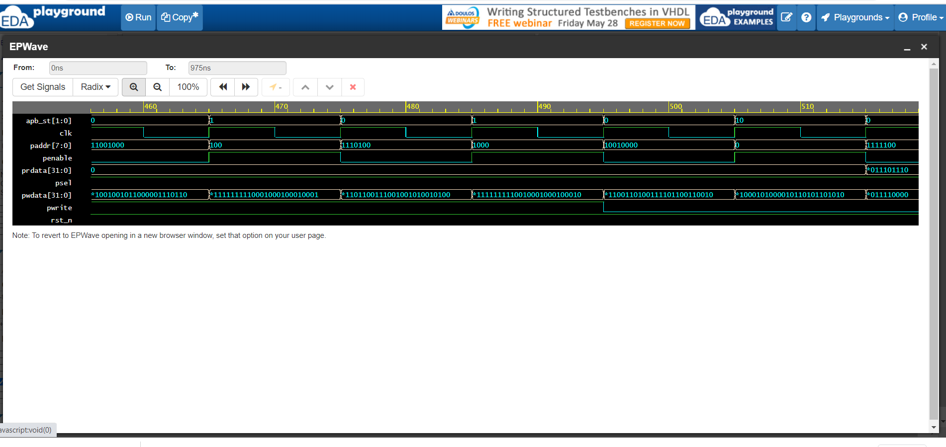
RD/WR General Simulation:
Note: To Check Code for this APB UVM Environment Visit my Github profile:
https://github.com/adnanashraf17501/apb_uvm

Slide 24
THANK YOU

